Slide 1


1.Using method from one class to another.
2.String.
KVS CHARAN(T1735)
A Quest Global Company

Slide 2
Using method from one class to another
In object-oriented programming, calling a function from one class to another typically involves creating an instance (object) of the second class inside the first class. This allows the first class to call methods or functions from the second class.
In Java, calling a method from one class to another is similar to what we do in other object-oriented languages. The key is to create an object (instance) of the class whose method you want to call and then invoke the method on that object.
Creating an Object: In both examples, an object of Class A is created inside Class B using new A().
Calling the Method: The method from Class A is invoked using the object, for example, classA.show() or classA.add().
Access Modifiers: Make sure that the methods you're trying to call have appropriate access modifiers (public, protected, or private) to ensure visibility from another class. In the examples above, the methods are marked as public so they can be accessed from other classes.

Slide 3
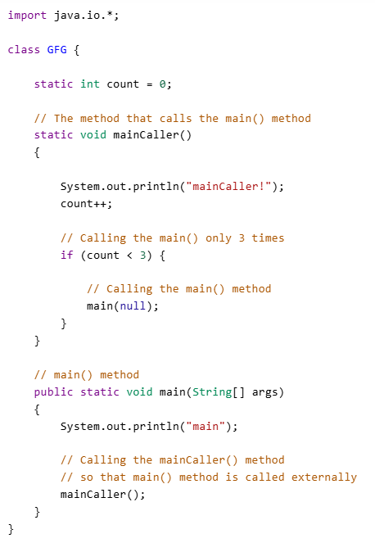
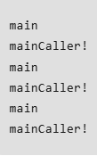
Code
Output

Slide 4
Strings
In Java, String is the type of objects that can store the sequence of characters enclosed by double quotes and every character is stored in 16 bits i.e using UTF 16-bit encoding. A string acts the same as an array of characters. Java provides a robust and flexible API for handling strings, allowing for various operations such as concatenation, comparison, and manipulation.
String Comparision:In Java, string comparison is a common task that you can accomplish in several ways depending on the type of comparison you need to perform. Using operators

Slide 5
Output
Code
public class Green {
public static void main(String args[])
{
String str = new String("This is string");
System.out.println(str);
}
}
This is string

Slide 6
String Concatenation
The string concat() method concatenates (appends) a string to the end of another string. It returns the combined string. It is used for string concatenation in Java. It returns NullPointerException if any one of the strings is Null.
We can use symbol ‘+’ also concat() to do the concatenation.
Code
class bf {
public static void main(String args[]) {
String s = "Greetings";
s = s.concat("foryou");
System.out.println(s);
}
}
Output
Greetingsforyou

Slide 7
String Comparision
In Java, there are different ways to compare strings. Since strings in Java are objects, you need to use specific methods for comparison rather than the == operator. The methods to compare strings depend on what aspect of the string you're trying to compare—whether it's checking for equality or ordering.
Code
String str1 = new String("namasthe");
String str2 = new String("Namasthe");
if (str1 == str2) {
System.out.println("Strings are equal");
} else {
System.out.println("Strings are not equal");
}
Output
Strings are not equal

Slide 8
String Start
In Java, the term "string start" typically refers to checking whether a string begins with a specific prefix. This can be achieved using the startsWith() method.
boolean startsWith(String prefix) is syntax.
Code
String str = "Hello Boss";
boolean result = str.startsWith("Hello");
if (result) {
System.out.println("The string starts with Hello");
}
else {
System.out.println("The string does not start with 'Hello'");
}
Output
The string starts with Hello

Slide 9
String End
In Java, the term "string end" typically refers to checking if a string ends with a specific suffix. You can achieve this using the endsWith() method.
boolean endsWith(String suffix) is the syntax.he endsWith() method in Java is a straightforward and effective way to check if a string ends with a specific suffix. It's commonly used for tasks like validating file extensions, URLs, or strings that follow a particular pattern.
Code
String str = "Hi Nanna";
boolean result = str.endsWith("Nanna");
if (result) {
System.out.println("The string ends with Nanna");
}
else {
System.out.println("The string does not end with Nanna");
}
Output
The string ends with Nanna

Slide 10
String Contains
In Java, the contains() method is used to check if a string contains a particular sequence of characters (a substring). It is part of the String class and provides an easy way to determine if one string is present within another.
boolean contains(CharSequence sequence) is the syntax.
String is case-sensitive.
Common Use Cases
Search for Substrings: Checking whether a specific substring exists within a larger string.
Text Parsing: Verifying if a string contains a particular keyword or phrase.
User Input Validation: Ensuring that user input contains certain required values or patterns

Slide 11
Output
Code
String strg = "Aham brahmasmi Tat Tvam Asi";
boolean result = strg.contains("Brahmasmi");
if (result)
{
System.out.println("contains Brahmasmi");
}
else
{
System.out.println("Does not contain Brahmasmi");
}
Does not contain Brahmasmi

Slide 12
String Trim
In Java, the trim() method is used to remove leading and trailing whitespace characters from a string. This is particularly useful when you're processing user input or reading data from external sources where extra spaces might be unintentionally included.
String trimmedString = string.trim(); is the syntax.
The method does not modify the original string because strings in Java are immutable. It returns a new string with the leading and trailing spaces removed.
Left Trim
In Java, there is no built-in method specifically called "left trim" in the String class, but you can achieve this functionality using other methods. Left trim refers to removing the leading whitespace characters (spaces, tabs, etc.) from the beginning of a string, while leaving the trailing characters intact.
Right Trim
In Java, there is no built-in method specifically called "right trim" in the String class, but you can achieve this functionality using various methods. Right trim refers to removing trailing whitespace characters (spaces, tabs, etc.) from the end of a string, while leaving the leading characters intact.

Slide 13
Output 1
Code1
String strg = " Hello,Laila ";
String trimmedStrg = strg.trim();
System.out.println("Original: '" + strg + ".");
System.out.println("Trimmed:'" + trimmedStrg + "'");
Code2
String strg = " Hello,Laila ";
String lefttrimmedStrg = strg.trim();
System.out.println("Original: '" + strg + ".");
System.out.println("LeftTrimmed:'" + trimmedStrg + ".");
Original: Hello,Laila .
Trimmed:Hello,Laila
Output 2
Original: Hello,Laila .
LeftTrimmed:Hello,Laila .

Slide 14
Output 3
Code 3
String strg = " Hello,Laila ";
String trimmedStrg = strg.trim();
System.out.println("Original: '" + strg + ".");
System.out.println("RightTrimmed: '" + trimmedStrg + ".");
Original: Hello,Laila .
RightTrimmed: Hello,Laila.

